Slide 1


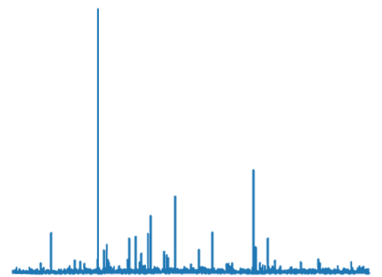
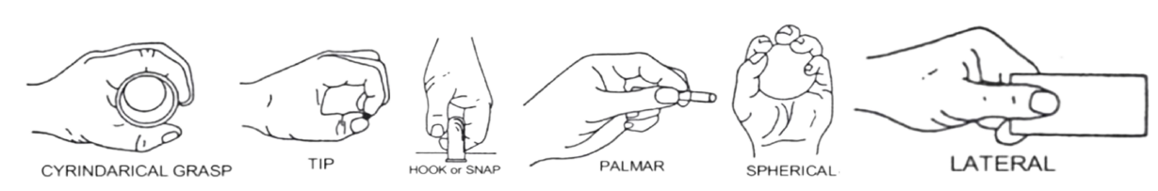
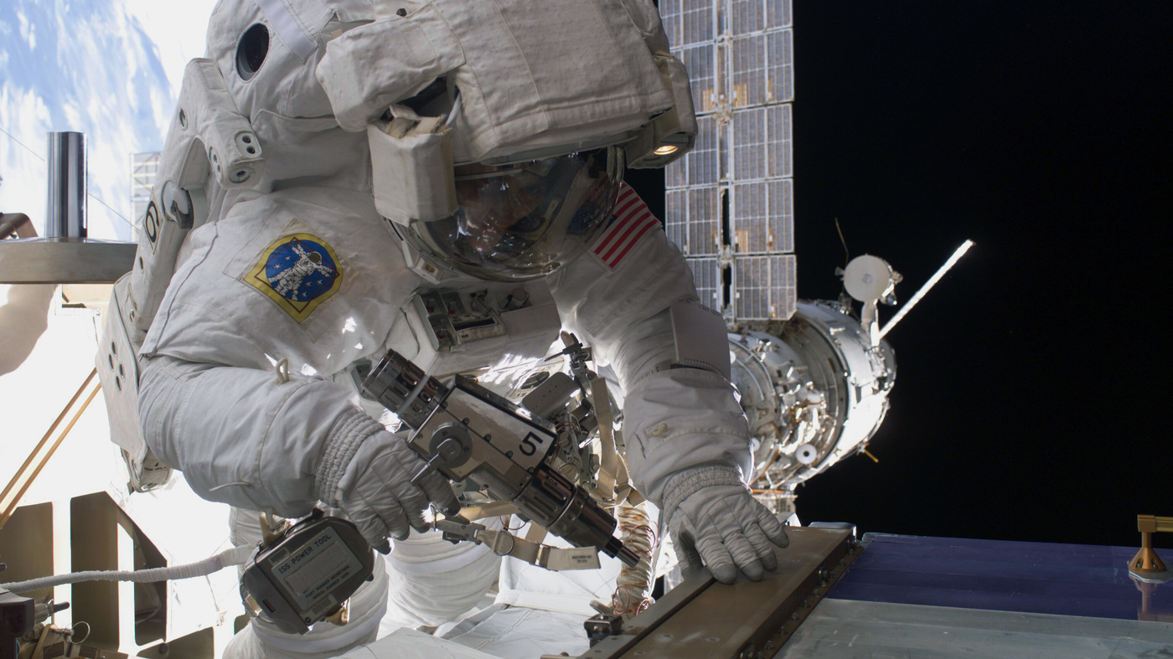
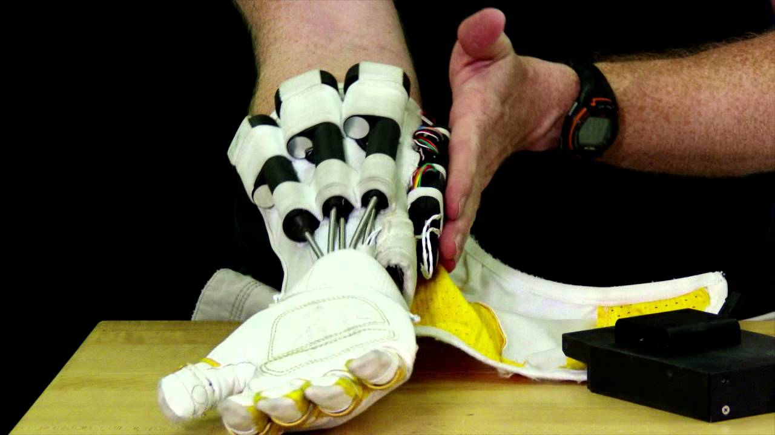
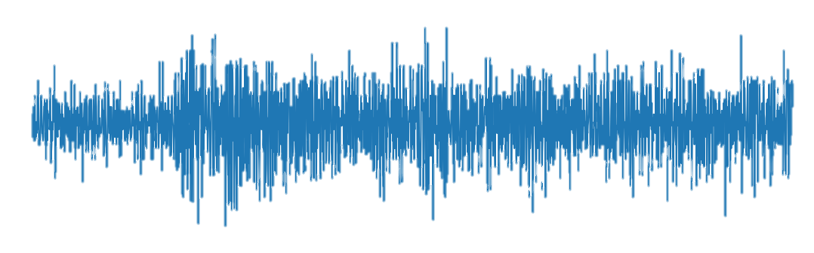

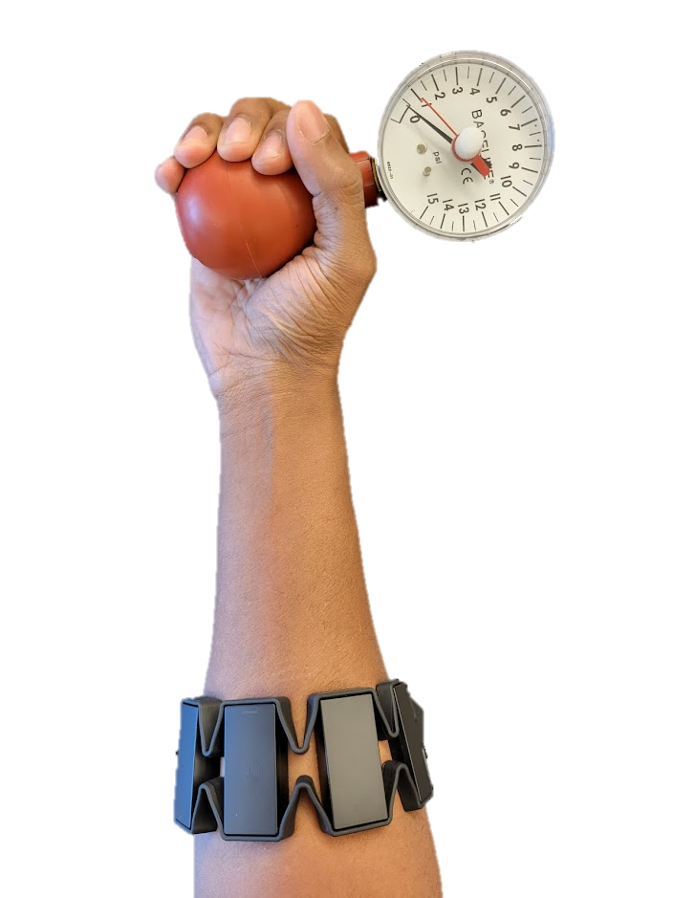
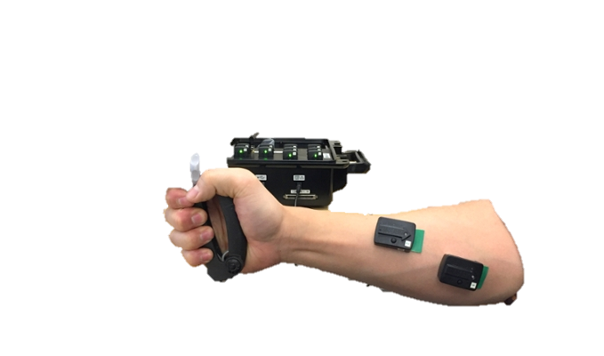
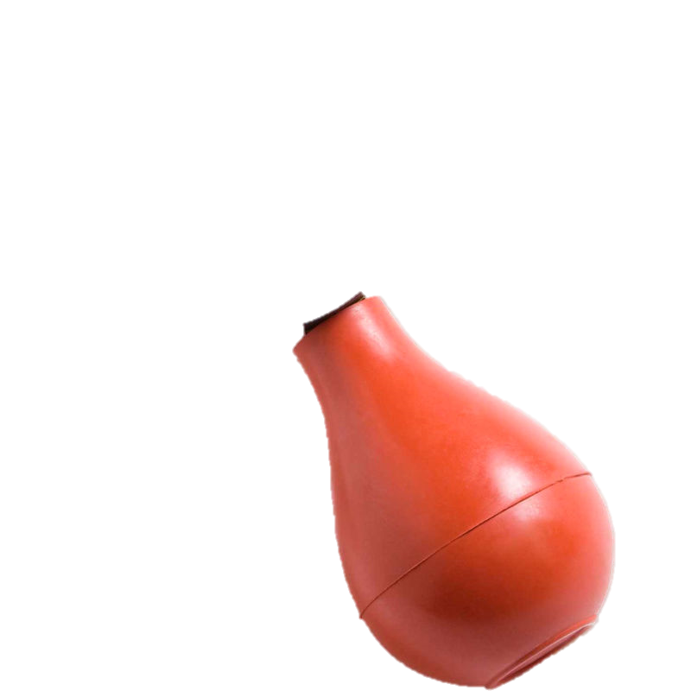
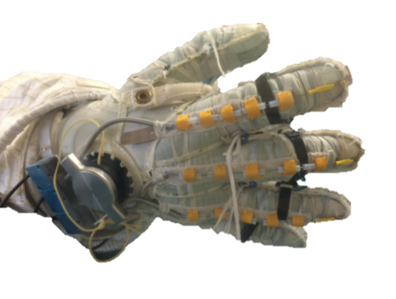
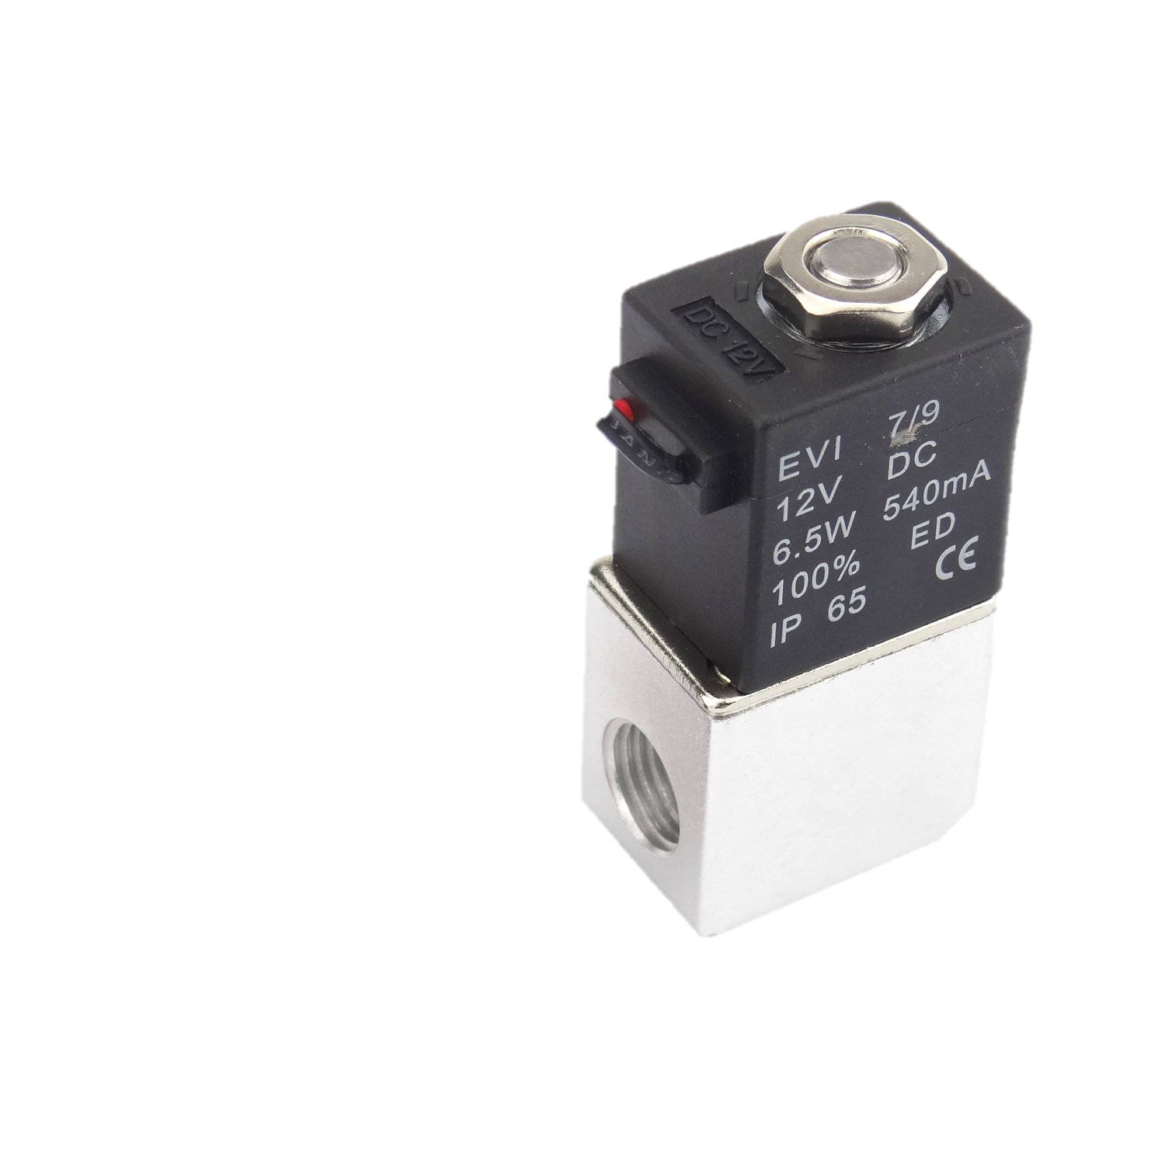
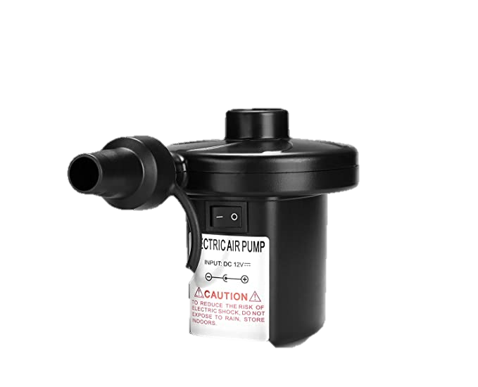
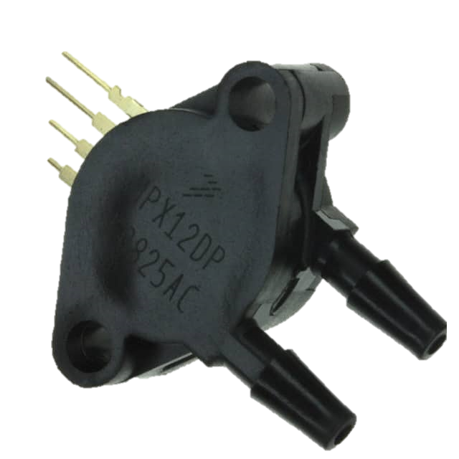

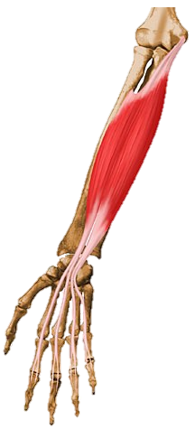
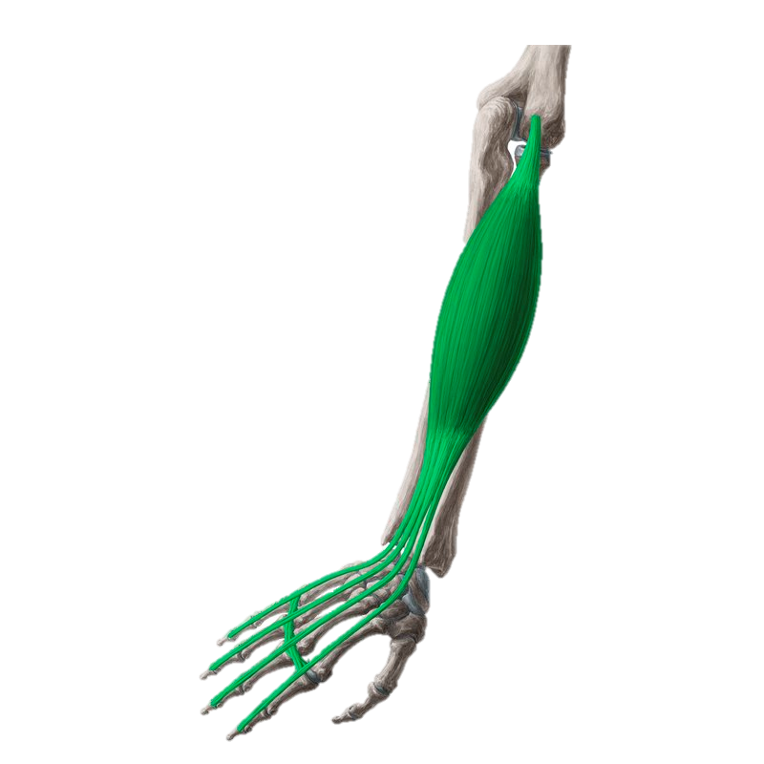
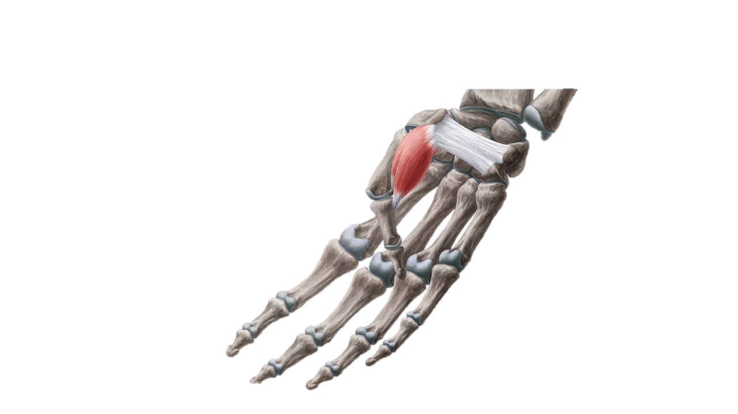
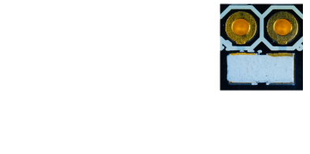

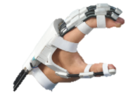
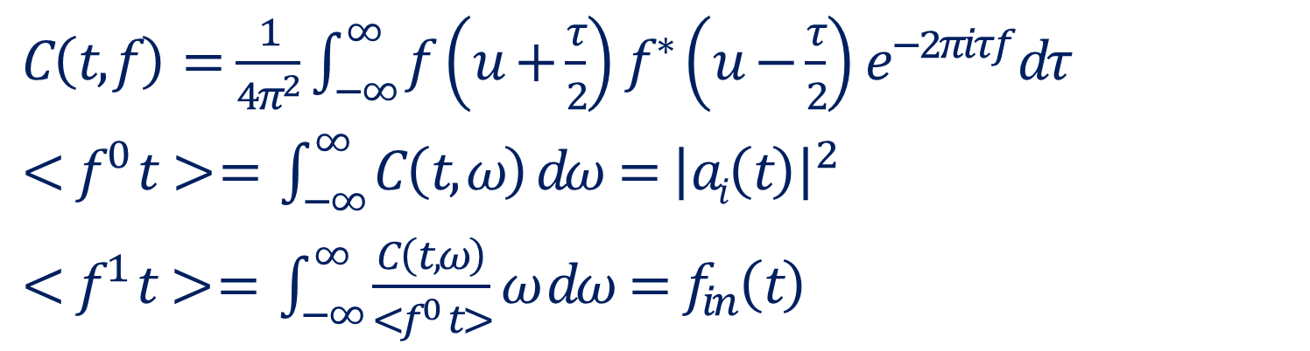
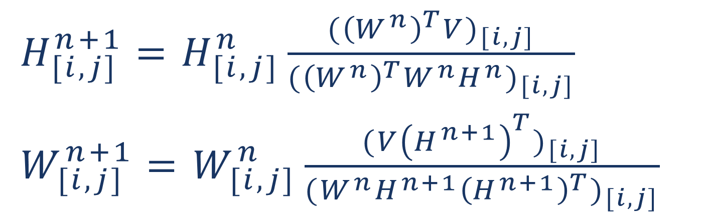
Toward the Future of Manned Space Exploration:
A Novel Wearable Interface for Optimal Human-Robot Collaboration
Avinash Baskaran and Dr. Chad G. Rose
Department of Mechanical Engineering, Auburn University
BACKGROUND
IMPLEMENTATION
Human-Robot interaction (HRI) can help astronauts during dangerous or taxing EVAs by providing assistive forces and torques to reduce neuromuscular load
Sub-optimal interaction between humans and robots produces antagonistic forces and torques, diminishing control stability and degrading performance
Modeling fatigue: For non-isometric tasks, changes in sEMG time-frequency spectral characteristics correlate to muscular fatigue
Estimating intent: Decomposition of sEMG signal matrices provides contributions of muscles (W_{[i,j]}) to intended movements, (H_{[i,j]}).
Intent Prediction Process
$H_{[i,j]}^{n+1}=H_{[i,j]}^{n}\frac{{({\left(W^{n}\right)}^{T}V)}_{[i,j]}}{{({\left(W^{n}\right)}^{T}W^{n}H^{n})}_{[i,j]}}$
$W_{[i,j]}^{n+1}=W_{[i,j]}^{n}\frac{{(V{\left(H^{n+1}\right)}^{T})}_{[i,j]}}{{(W^{n}H^{n+1}{\left(H^{n+1}\right)}^{T})}_{[i,j]}}$
Pose detected
Fatigue Estimation Process
$C\left(t,f\right)=\frac{1}{4π^{2}}\int_{−∞}^{∞}{f}\left(u+\frac{τ}{2}\right)f^{∗}\left(u−\frac{τ}{2}\right)e^{−2πiτf}dτ$
$<f^{0} t> = \int_{−∞}^{∞}{C\left(t,ω\right) dω={\left|ai\left(t\right)\right|}^{2}}$
$<f^{1} t> = \int_{−∞}^{∞}{\frac{C\left(t,ω\right)}{<f^{0} t>}ω dω=f_{in}\left(t\right)}$
Original sEMG signal (5 sec)
TFD Signal energy
(left: Astronaut Sunita Williams using a high torque hand-held tool, right: A robotic hand device for assistance during space walks)
Hand activity
Fatigue detected
METHODS
Experimental Validation Protocol
(current stage)
3D printed flexible surface electrodes embedded in a wearable device allow for analysis of neuromuscular characteristics including fatigue and movement intent.
Stage 1. Validation
Stage 2. Comprehensive human subjects trial
Stage 3. Trial with spacesuit conditions
Human
Robot
CONCLUSIONS
FORCES
Preliminary results suggest that the interface is able to model both neuromuscular fatigue and movement intent accurately, advancing the state of the art in HRI
This work meets a need in the literature, as no other work has presented such an approach. It also meets practical needs in Space-suit mounted robotics and human robot interaction more broadly. Future work will include a comprehensive system usability study
SIGNALS
Wearable interface
The target muscles are: Flexor digitorum superficialis (left), extensor digitorum (middle), flexor pollicis brevis (right)
3D printed
Flexible sensor electronics
SIGNALS
REFERENCES
[6] K. E. Madden, A. Deshpande, B. J. Peters, J. M. Rogers, E. A. Laske, and E. McBryan. The influence of robotic assistance on reducing neuromuscular effort and fatigue during extravehicular activity glove use. 2017.
[7] J. Massion, V. Gurfinkel, M. Lipshits, A. Obadia, and K. Popov. [strategy and synergy: two levels of equilibrium control during movement. effects of the microgravity].Comptes rendus de l’Academie des sciences. Serie III, Sciences de la vie, 1992.
[8] K. Min, D. Shin, J. Lee, and S. Kakei. Electromyogram refinement using muscle synergy based regulation of uncertain information. Journal of biomechanics, 2018.
[9] S. A. Overduin, A. d’Avella, J. Roh, and E. Bizzi. Modulation of muscle synergy recruitment in primate grasping. J. of Neuroscience, 2008.
[10] J. Rogers, B. Peters, E. Laske, and E. McBryan. Development and testing of robotically assisted extravehicular activity gloves. 47th International Conference on Environmental Systems, 2017.
[11] C. G. Rose and M. O’Malley. Hybrid rigid-soft hand exoskeleton to assist functional dexterity. IEEE Rbtcs. and Automtn. Letters, 2019.
[12] S. A. Safavynia, G. Torres-Oviedo, and L. Ting. Muscle synergies: Implications for clinical evaluation and rehabilitation of movement. Topics in spinal cord injury rehabilitation, 2011.
[1] S. Boyas and A. Gu evel. Neuromuscular fatigue in healthy muscle: Underlying factors and adaptation mechanisms. Annals of Phys. and Rehab. Med., 2011.
[2] O. Celik, M. O’Malley, C. Boake, H. Levin, N. Yozbatiran, and T. Reistetter. Normalized movement quality measures for therapeutic robots strongly correlate with clinical motor impairment measures. IEEE Trans. on Neural Systems and Rehab. Engineering, 2010.
[4] M. L. Gernhardt, J. A. Jones, R. A. Scheuring, A. F. Abercromby, J. A. Tuxhorn, and J. R. Norcross. Risk of compromised eva performance and crew health due to inadequate eva suit systems. 2009.
[5] E. Jovanov, I. K. Small, T. D. Rolin, H. Ganegoda, and C. Hill. Long term monitoring of respiration and co2 using flexible printed sensors. 2020.
Funded by: NASA Space Grant College and Fellowship Program

